Slide 1

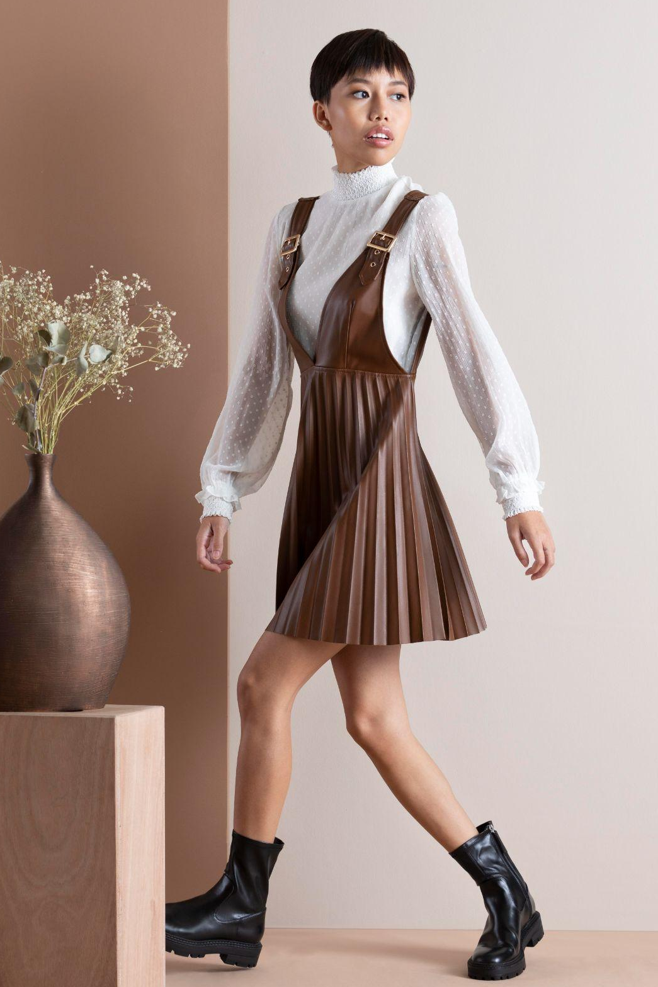
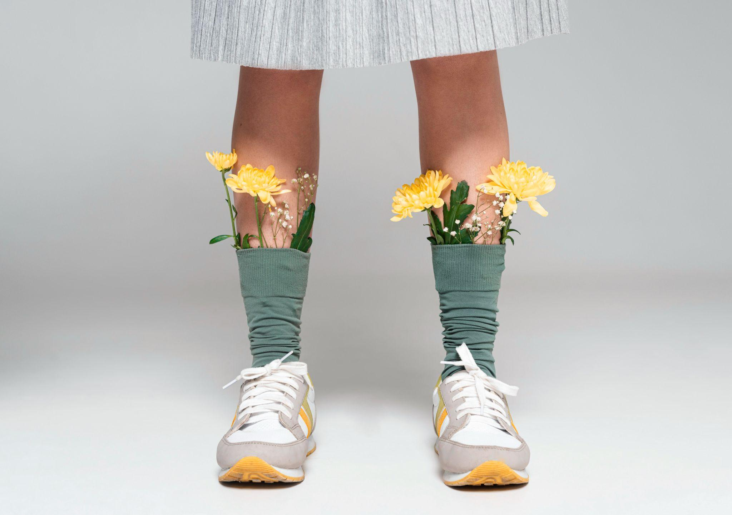
M2VIRA
THE FUTURE OF FASHION CLOTHES
@m2vira
@m2vira

Slide 2
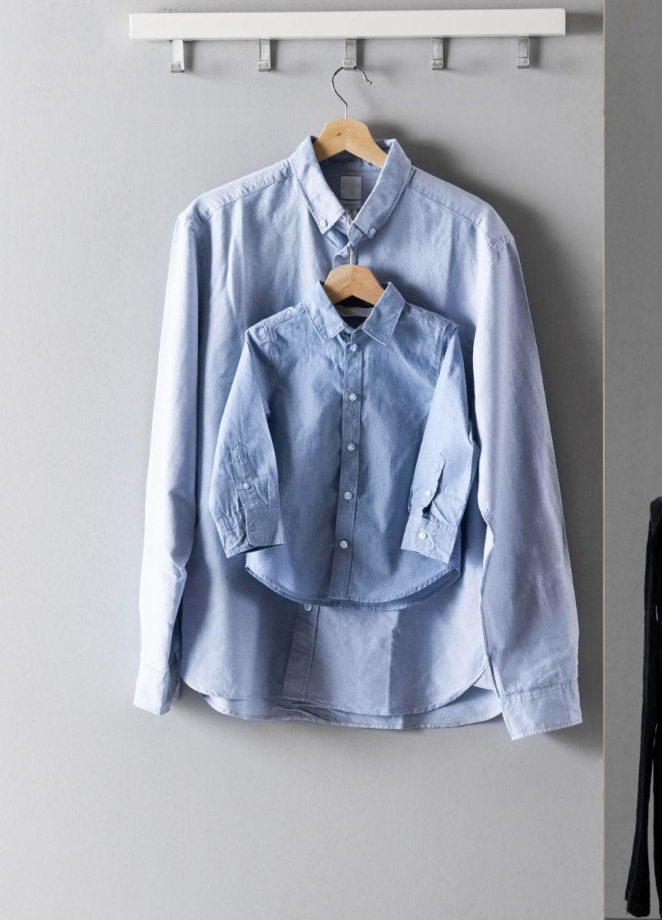
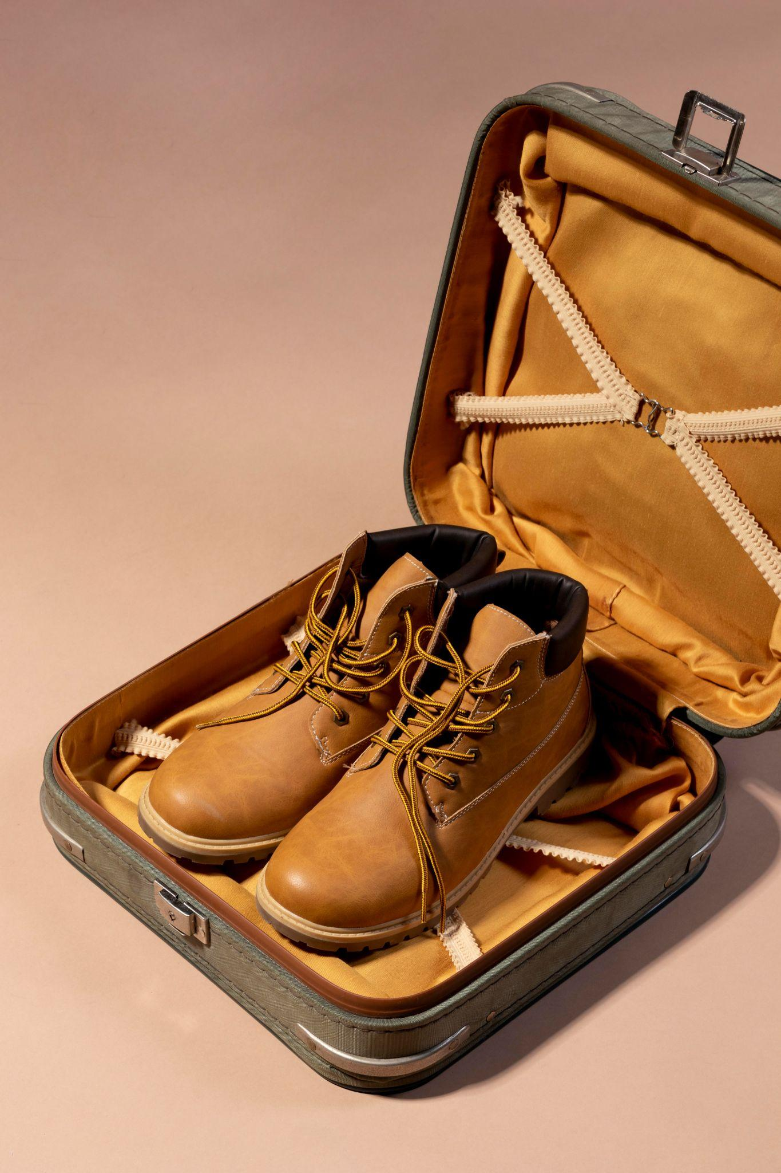
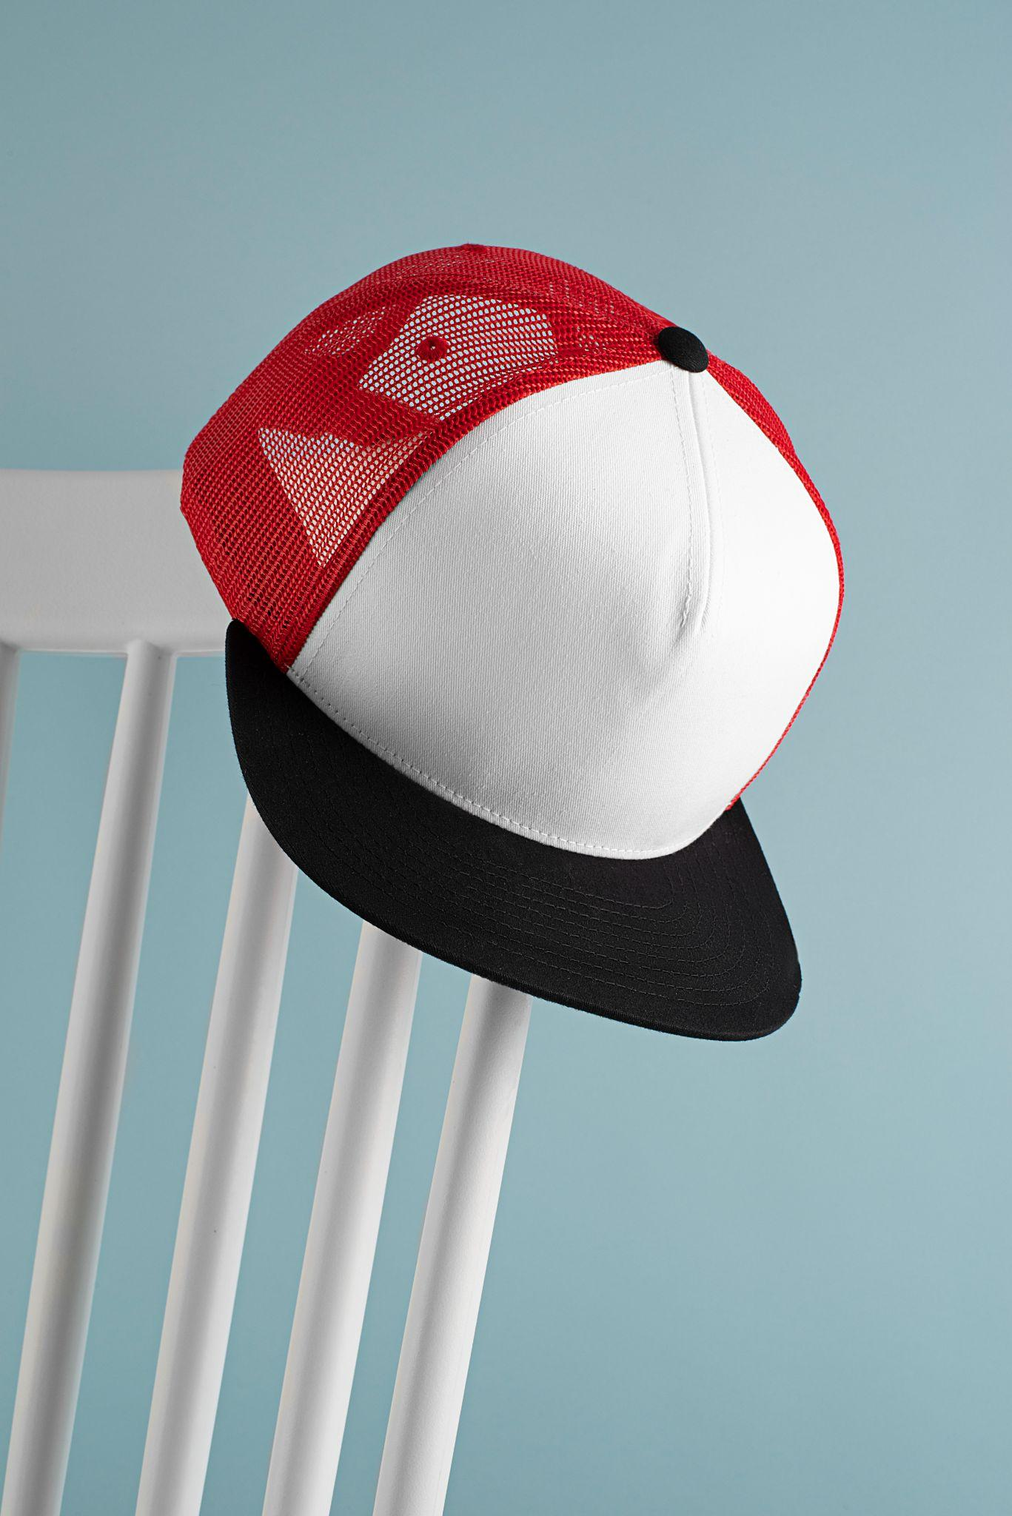
TABLE OF CONTENTS
01
02
03
04
TECHNOLOGIES
m2vira
DEMO
END

Slide 3
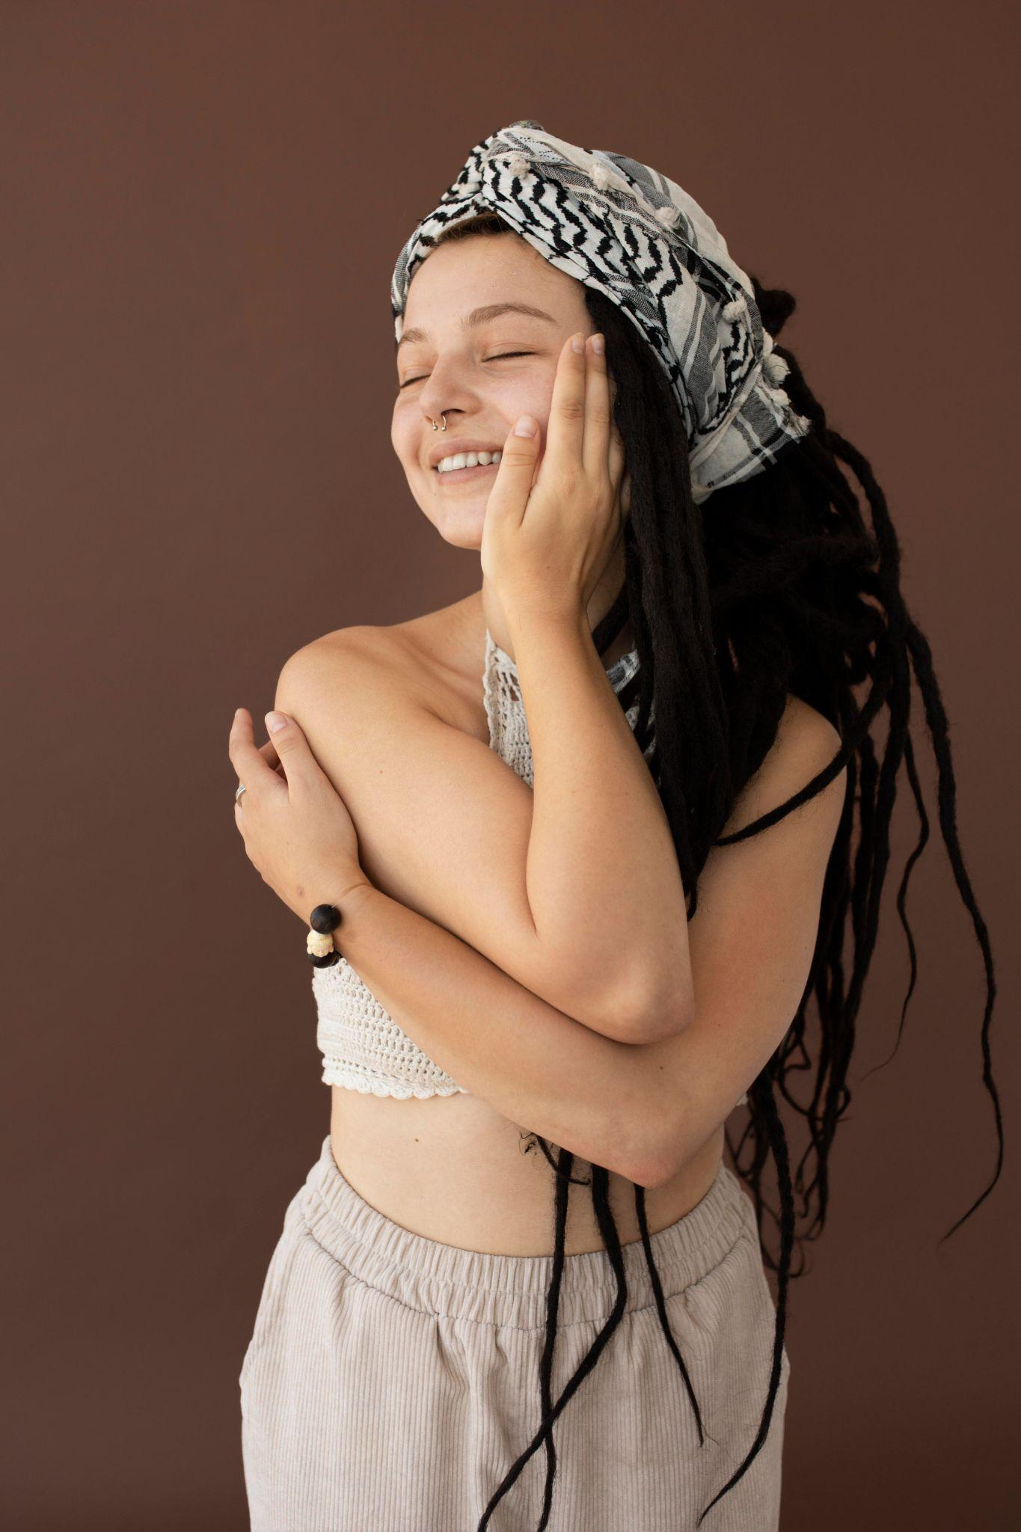

01
TECHNOLOGIES
@m2vira
@m2vira

Slide 4




TECHNOLOGIES
m2vira uses some modern technologies for it’s development.

Slide 5
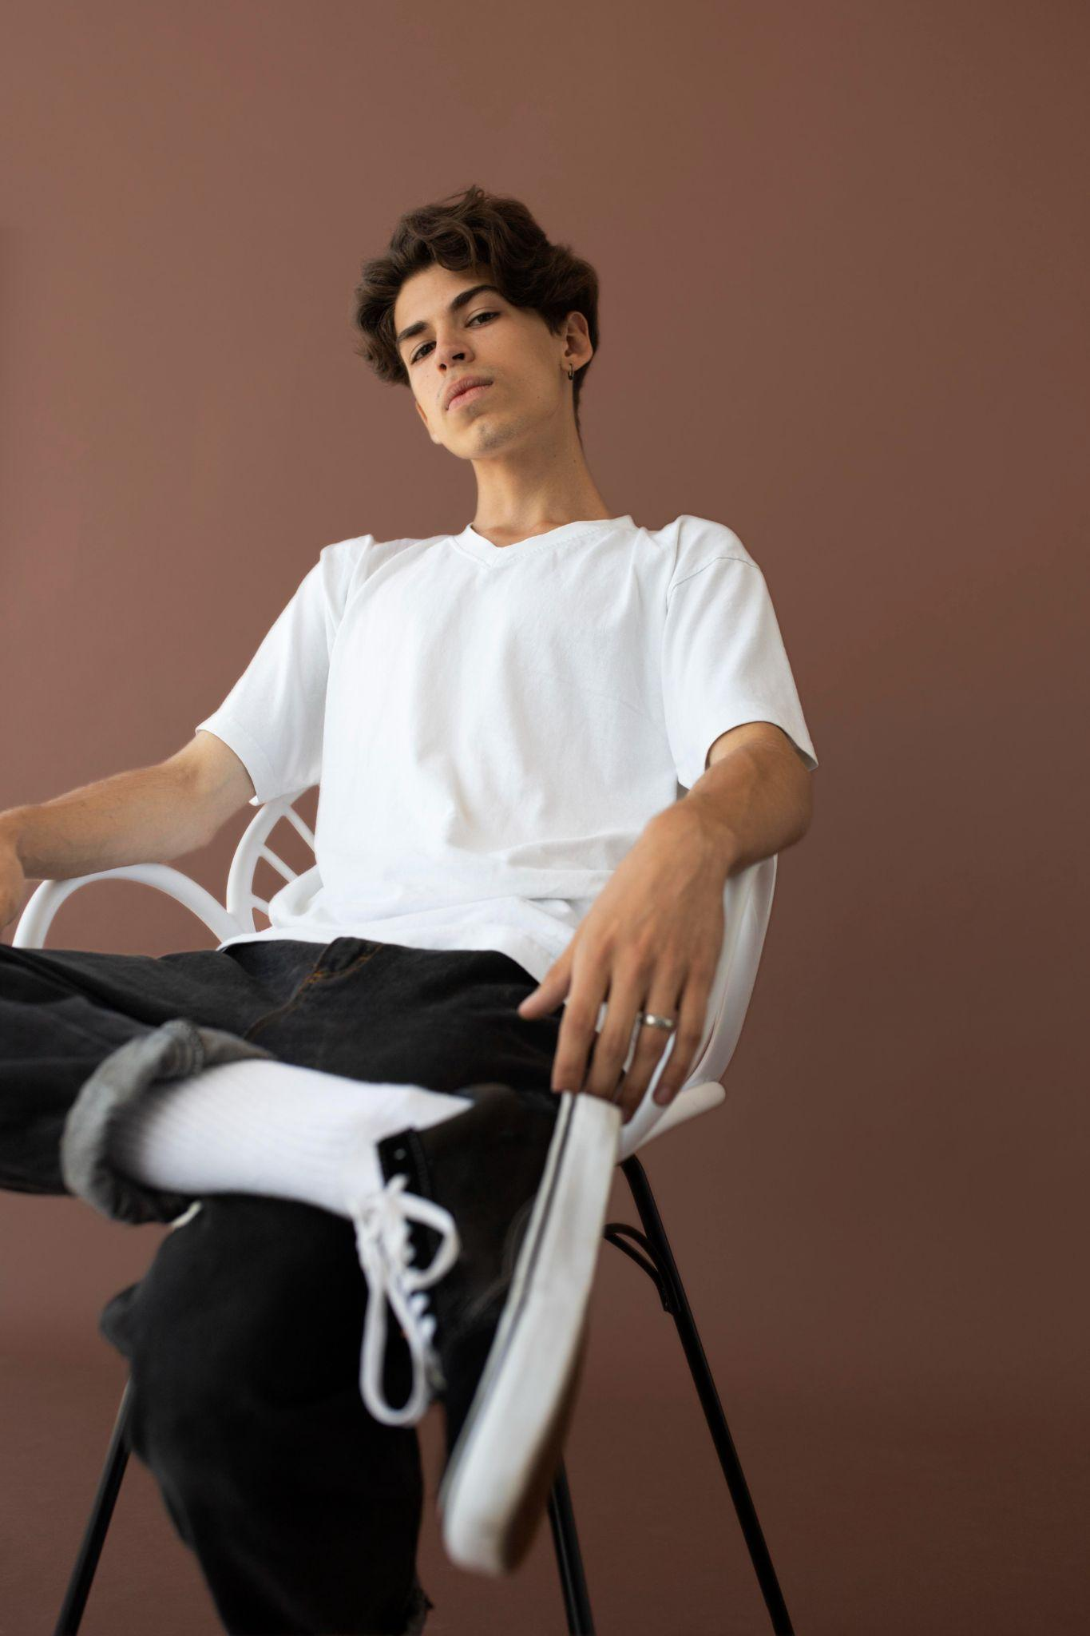
02
Vercel
@m2vira
@m2vira

Slide 6
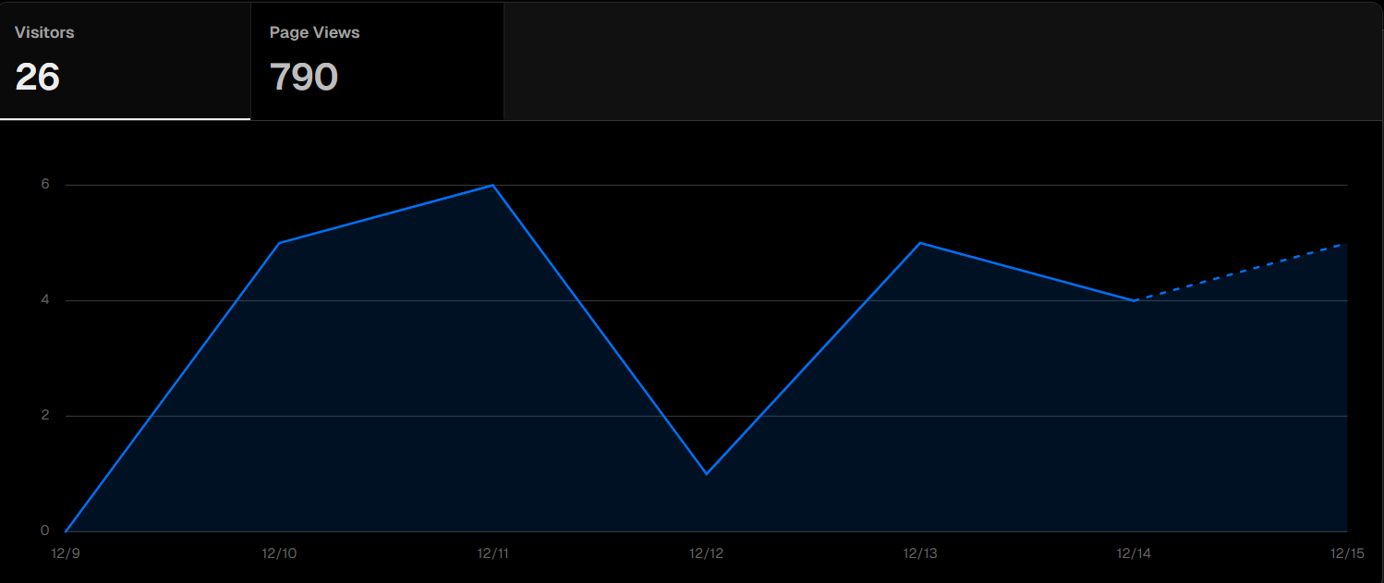
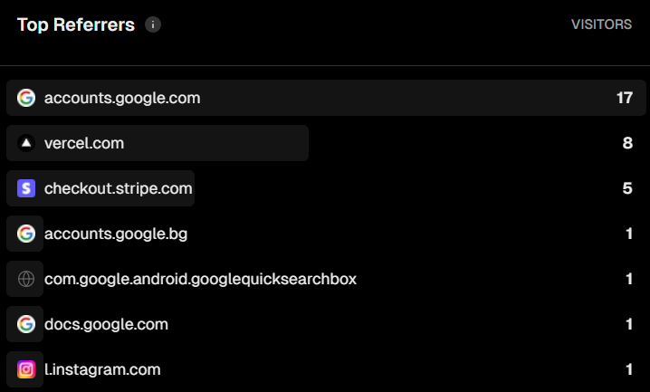
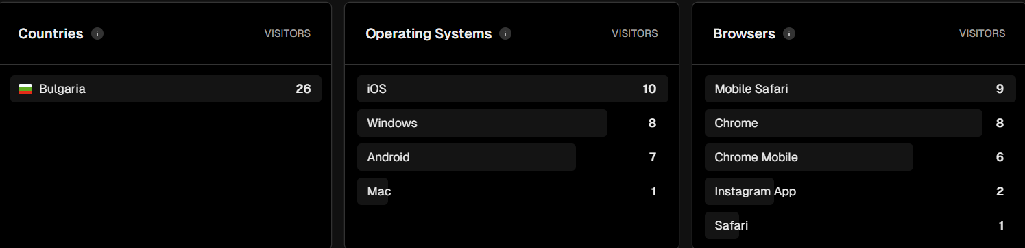
Vercel Analytics

Slide 7
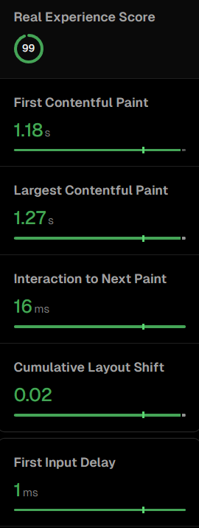
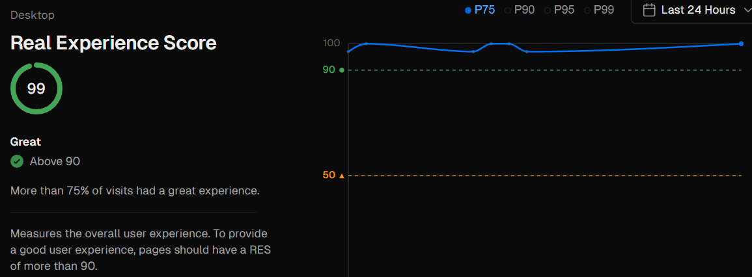
Vercel Speed Insights

Slide 8

LET’S HOP INTO THE DEMO → *click here*

Slide 9
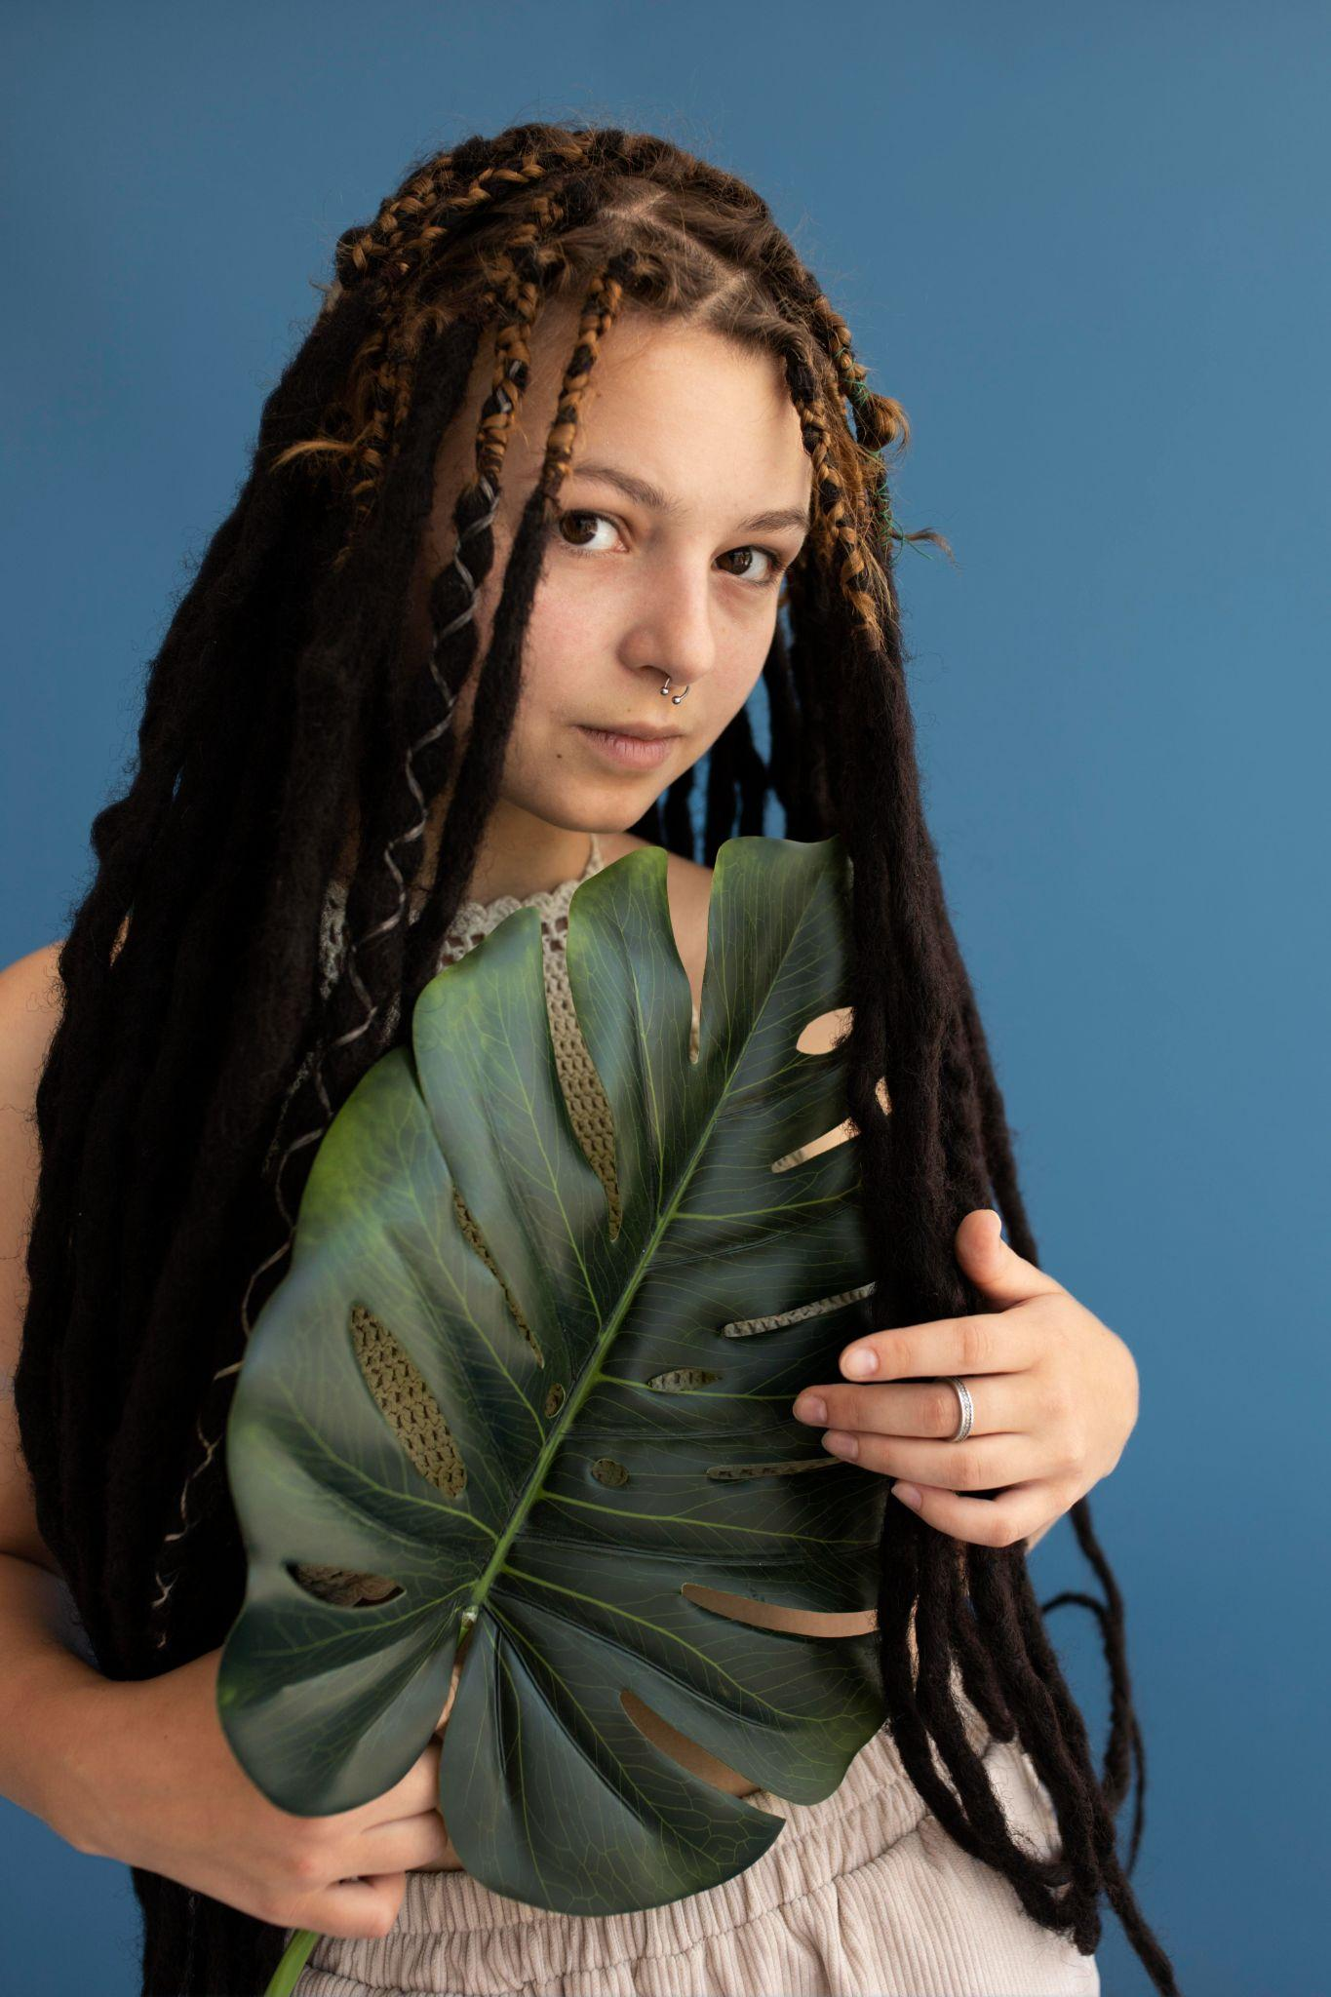
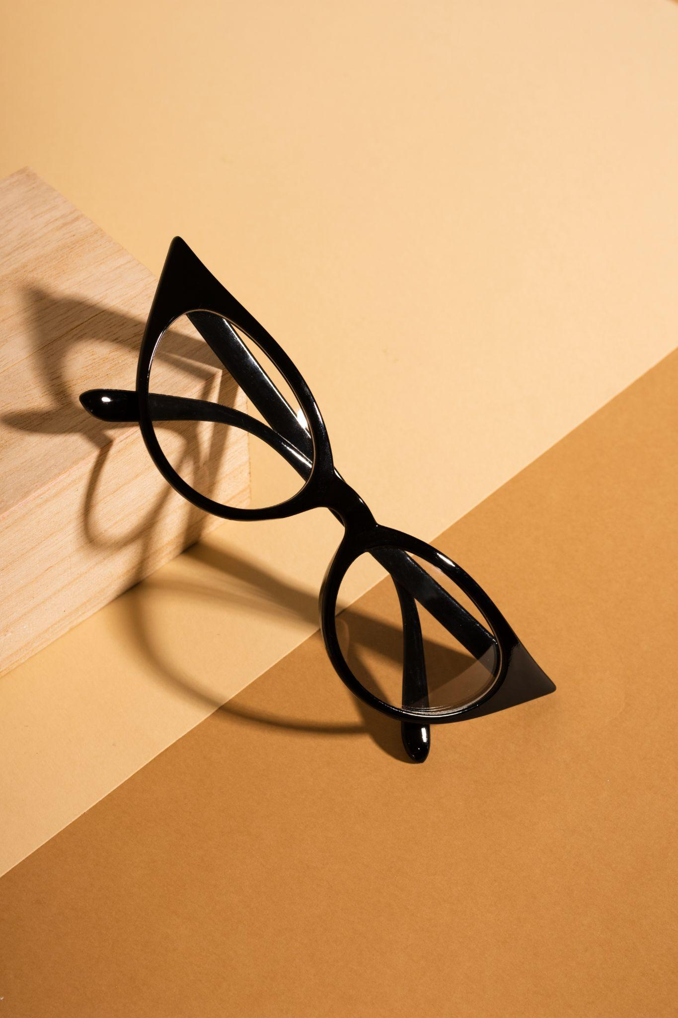
THANKS!
Any questions?
@modernclothing
@modernclothing

